Slide 1
HTS of polymer as artificial enzymes
f
Mixture of compounds
PNA encoded library
d
FRET-based labelll
a
Fluorescence signal
c
b
e
Polymer array (up to 10.000 different polymers)
d

Slide 2
d
d
c
f
c
f
b
e
b
e
a
d
a
d
DNA microarray
DNA microarray

Slide 3

a
b
c
a
b
c
Hybridization
on the chip
DNA-PNA microarray 2D
Polymer spotting
Peptide cleavage
(
A
A
)
n
a
Cell culture
Immunoassay

Slide 4
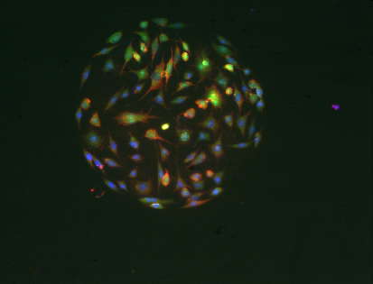
1
2
DNA microarray
4
3
b
b
b
DNA microarray
DNA microarray
DNA microarray
5
Encoded small-molecule
Hydrogel
Catalyst
Cleavable linker
Encoding tag
b
100 µm
DNA microarray
Cell-based phenotypic image taken by an automatised system

Slide 5
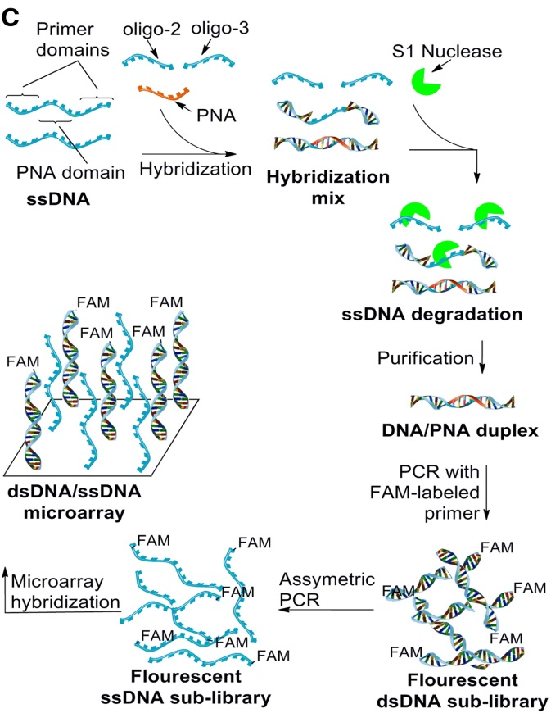
Encoded small-molecule
Scanning & Identification of apoptotic compounds
Cleavable linker
Encoding tag
Fluorescent microsphere
Lysis & hybridization
DNA microarray
Suspension cells
One-bead one-compound
Immunostaining & FACS
Anexin +/PI-
One-cell one-bead
Encoded chemical library
(10,000 members)
Anexin-/PI+
Scanning & Identification of necrotic compounds
Lysis & hybridization
DNA microarray

Slide 6
t=0
Time-lapses
t=xh
b
DNA microarray

Slide 7
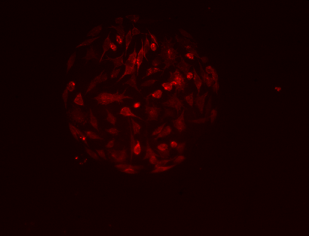
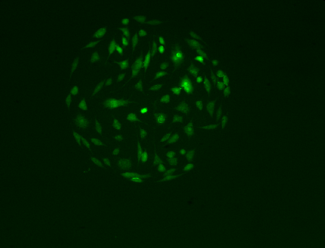
100 µm
100 µm
100 µm

Slide 8
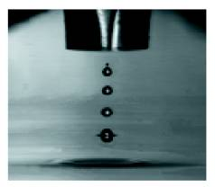

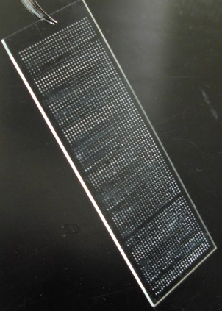
Masked glass slide
Initiator (APS)
Monomer 1 &
Monomer 2
Mixing
in situ
Polymerization

Slide 9
Encoded Chemical Libraries
Hits Identified
Lead Compounds
Candidates for in-vivo assays
Future
Current
In vitro Cell-based phenotypic assays
ChemArrays
Assays against targeted enzymes
Validation assays against targeted enzymes

